Slide 1

Analyzing Personal Expenses
This project simulates an expense tracker using Python Faker library, SQL, and Streamlit to analyze spending habits and provide insights into financial behavior.
By S Saranya

Slide 2
Objective
Expense Tracker
Data Processing
Visualization
Simulates a person’s monthly expenses using the Faker library.
Processes and stores data in a SQL database for querying and analysis.
Develops a Streamlit app to visualize insights and showcase SQL query outputs.

Slide 3

Business Use Cases
Expense Tracking
Financial Analysis
Automates tracking of personal or business expenses from e-commerce platforms.
Analyzes spending habits to create actionable savings plans.
Data Visualization
Builds financial dashboards for tracking income and expenditure trends.

Slide 4






Technical Tags Used
Python
EDA
SQL
Data Visualization
Streamlit

Slide 5

Methodology
1
Data Simulation
2
Database Creation
Generate a realistic dataset using the Faker library.
Create a SQL database schema and load the generated dataset.
3
Exploratory Data Analysis
4
Streamlit App Development
Analyze the dataset to extract insights about spending patterns.
Develop a user-friendly web application for visualization and query outputs.

Slide 6
Data Generation with Faker Library

Slide 7
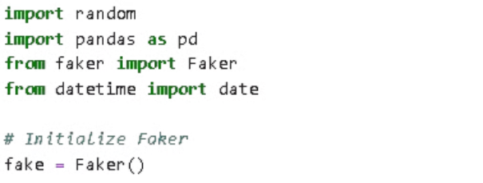
Libraries & Initialization
Imports necessary Python libraries: random, pandas, Faker, datetime. The random library is used for random number generation, crucial for simulating realistic expense data. pandas is essential for data manipulation and creating the DataFrame that will store the generated data. Faker provides the core functionality for generating realistic fake random expense data, and transaction details. Finally, datetime is used for generating realistic dates for each expense transaction.

Slide 8
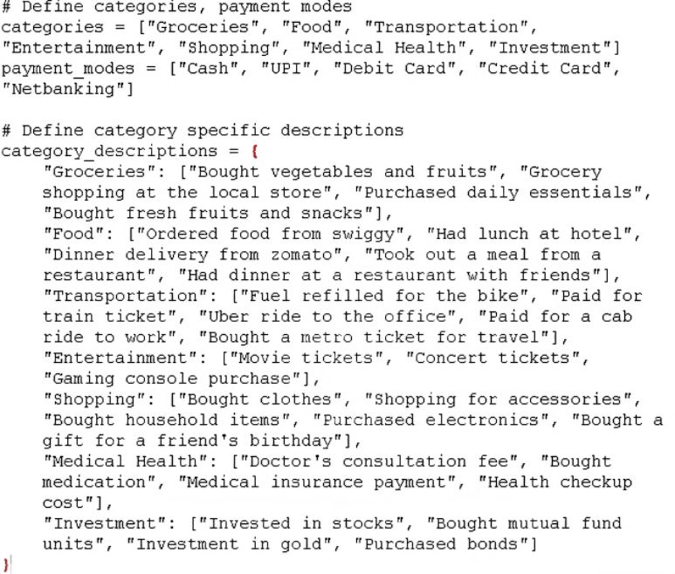
Categories & Payment Modes: Detailed Descriptions
This section defines expense categories (Groceries, Food, Transportation, Entertainment, Bills, etc.) and payment methods (Cash, UPI, Debit Card, Credit Card). This structure ensures realistic expense data generation.
Each expense category includes a detailed description, enhancing the believability and scope of the simulated spending scenarios.

Slide 9
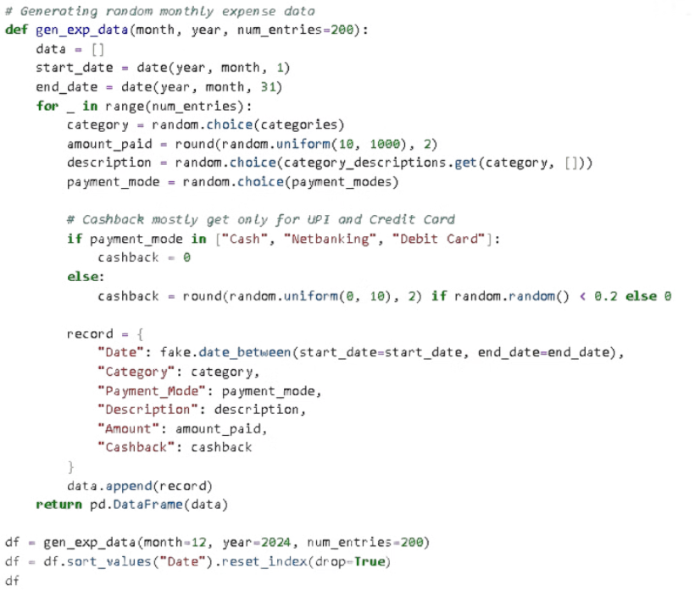
Expense Data Generation
The core function, gen_exp_data(), generates a specified number (default is 200) of expense entries for a given month and year. For each entry, it randomly selects a category, generates a realistic description using Faker, chooses a payment method, and calculates a random transaction amount. It also incorporates a realistic cashback mechanism, randomly applying cashback percentages to simulate rewards programs. This ensures that the generated dataset accurately reflects real-world spending patterns, including reward structures.

Slide 10
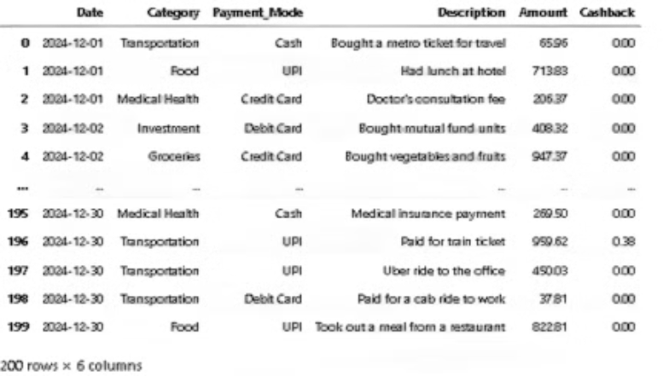
DataFrame Output
The function returns a Pandas DataFrame, a highly efficient data structure for data analysis and manipulation in Python. This DataFrame contains columns for Date, Category, Payment Mode, Description, Amount, and Cashback. The inclusion of cashback adds another layer of realism to the data, mimicking the incentives found in many payment systems. This structured output simplifies subsequent data analysis and visualization steps in the project.

Slide 11
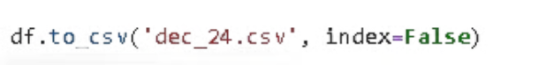
Save as CSV
The generated 12-month dataset will be saved as individual CSV files.

Slide 12
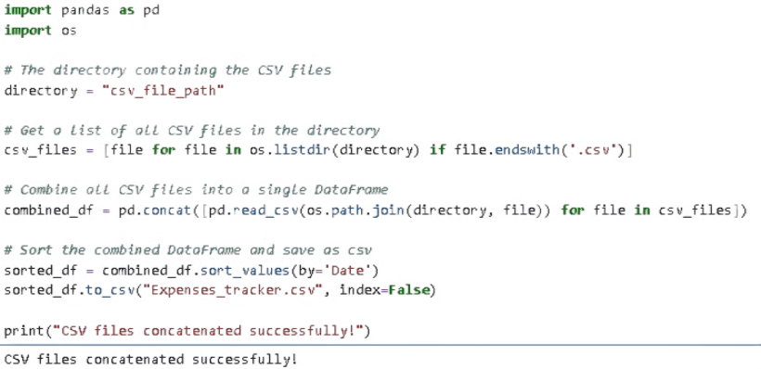
Combining Monthly CSV Files
Twelve monthly CSV files are combined into a single yearly dataset using Python's 'import os' module for efficient file handling and data integration.

Slide 13
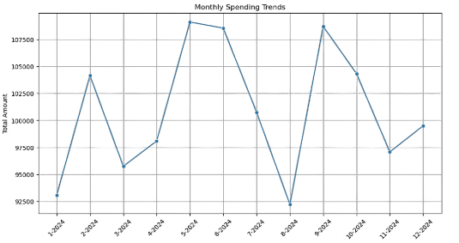
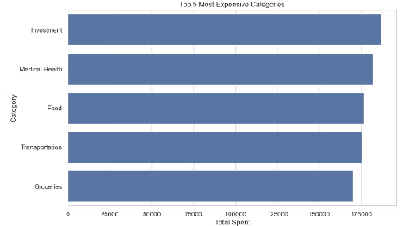
Exploratory Data Analysis
This phase involves a thorough examination of the synthetic personal expense dataset (generated using the Faker library, as described in previous slides). We will identify and address any data quality issues, such as duplicates, missing values, and inconsistencies. Pandas' df.describe() function will provide summary statistics (mean, median, standard deviation, minimum, and maximum values) for numerical data (transaction amounts and cashback). The 'Date' column will be converted to a datetime format to facilitate time-series analysis.
Analyze monthly spending patterns: A bar chart will visualize total spending per category, highlighting the highest and lowest spending categories ("Investment" having the highest and "Shopping" the lowest expenses).
Identify monthly spending trends: A line chart will illustrate total expenses over time, pinpointing the months with the highest ("May") and lowest ("August") spending.
Analyze transaction frequency by payment method: A bar chart will display the transaction count for each payment method, identifying the most frequently used methods.
Analyze spending by payment method: A bar chart will show the total spending for each payment method, revealing the highest ("Credit card") and lowest ("Debit card") spending methods.
Identify top 5 expense categories: A bar chart will present the top 5 most expensive expense categories.

Slide 14
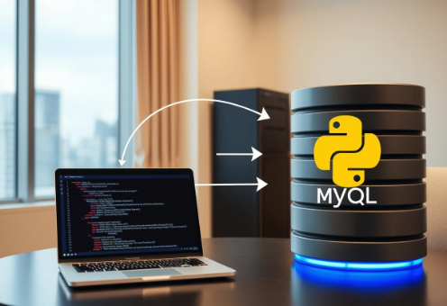
Connecting Python to MySQL
Import the necessary library: Begin by importing the `pymysql` library, which provides the necessary functions to interact with MySQL databases from Python. Use the statement: import pymysql
Establish a database connection: Create a connection object using the `pymysql.connect()` method. This requires specifying connection parameters such as host, user, password, and database name. For example: conn = pymysql.connect(host='your_host', user='your_user', password='your_password', database='your_database')
Create a cursor object: A cursor object allows you to execute SQL queries. Create one using: cursor = conn.cursor()
Load CSV data into a Pandas DataFrame: Read your CSV data into a Pandas DataFrame using: df = pd.read_csv('your_file.csv') Ensure the Pandas library is imported: import pandas as pd
Create a MySQL database and table: If the database and/or table don't exist, create them using SQL queries executed via the cursor. For example: cursor.execute("CREATE DATABASE IF NOT EXISTS your_database") cursor.execute("USE your_database") cursor.execute(""" CREATE TABLE IF NOT EXISTS your_table ( id INT AUTO_INCREMENT PRIMARY KEY, column1 VARCHAR(255), column2 INT, column3 DATE ) """) Adapt the table schema (column names and data types) to match your CSV data.
Insert data into the table: Iterate through the Pandas DataFrame and insert each row into the MySQL table using parameterized queries to prevent SQL injection vulnerabilities. For example: for index, row in df.iterrows(): cursor.execute("INSERT INTO your_table (column1, column2, column3) VALUES (%s, %s, %s)", (row['column1'], row['column2'], row['column3'])) conn.commit()
Close the connection: After completing all operations, close the database connection using: conn.close()

Slide 15
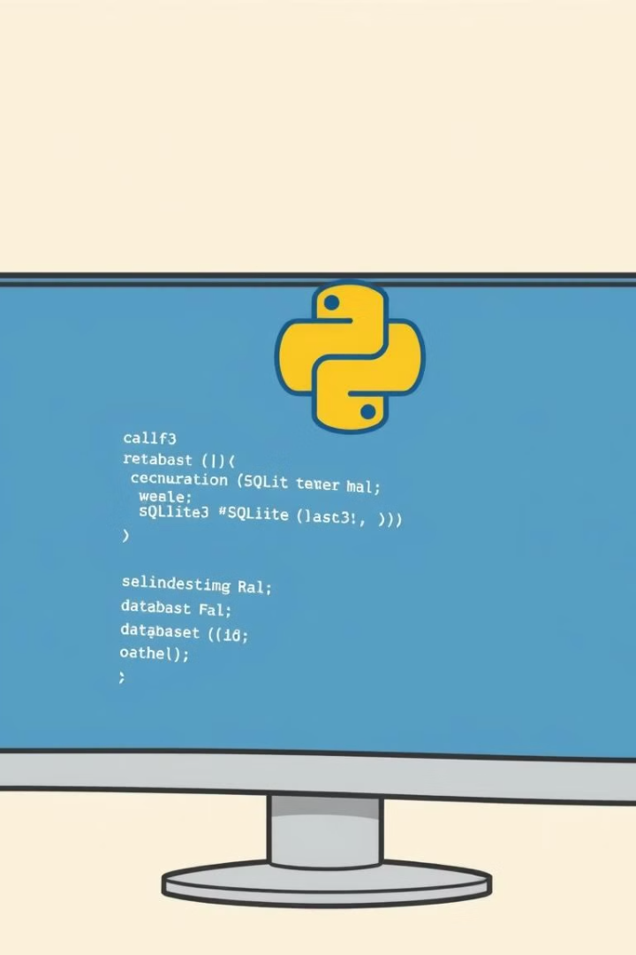
Alternative Method: Connecting Python to SQLite3
Due to deployment challenges with MySQL (incompatibilities and access issues within Streamlit), I switched to SQLite3 for successful deployment. This simplified the process, eliminating external database dependencies and reducing infrastructure complexity. The solution involved creating a local SQLite3 database, defining the table schema, inserting data via parameterized queries, and handling exceptions.

Slide 16
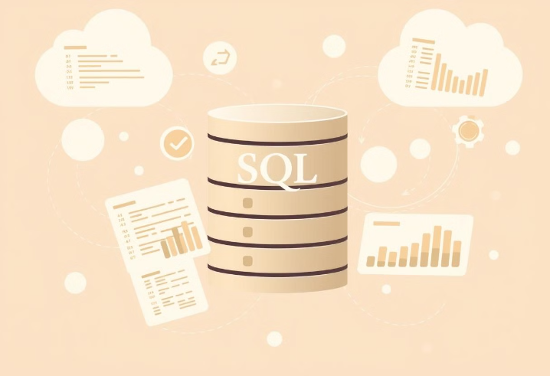
SQL Query
The data analysis leveraged multiple SQL queries executed against the MySQL database. Key analytical queries included:
SELECT Category, SUM(Amount) AS Total_spent, AVG(Amount) AS Avg_spent, MAX(Amount) AS Max_spent, MIN(Amount) AS Min_spent FROM Expense_tb GROUP BY Category ORDER BY Total_spent, Avg_spent, Max_spent, Min_spent; (Analyzing spending patterns by calculating total, average, minimum, and maximum expenditures per category)
SELECT Category, COUNT(*) AS Total_trans FROM Expense_tb GROUP BY Category ORDER BY Total_trans DESC; (Determining transaction frequency across different expense categories)
SELECT SUM(Amount) AS Total_Expense FROM Expense_tb; (Computing overall total expenses)
These queries, along with an additional 17 analytical queries, formed a comprehensive approach to addressing 11-15 key project questions. The query results provided the critical foundation for subsequent data visualizations and statistical analysis.

Slide 17

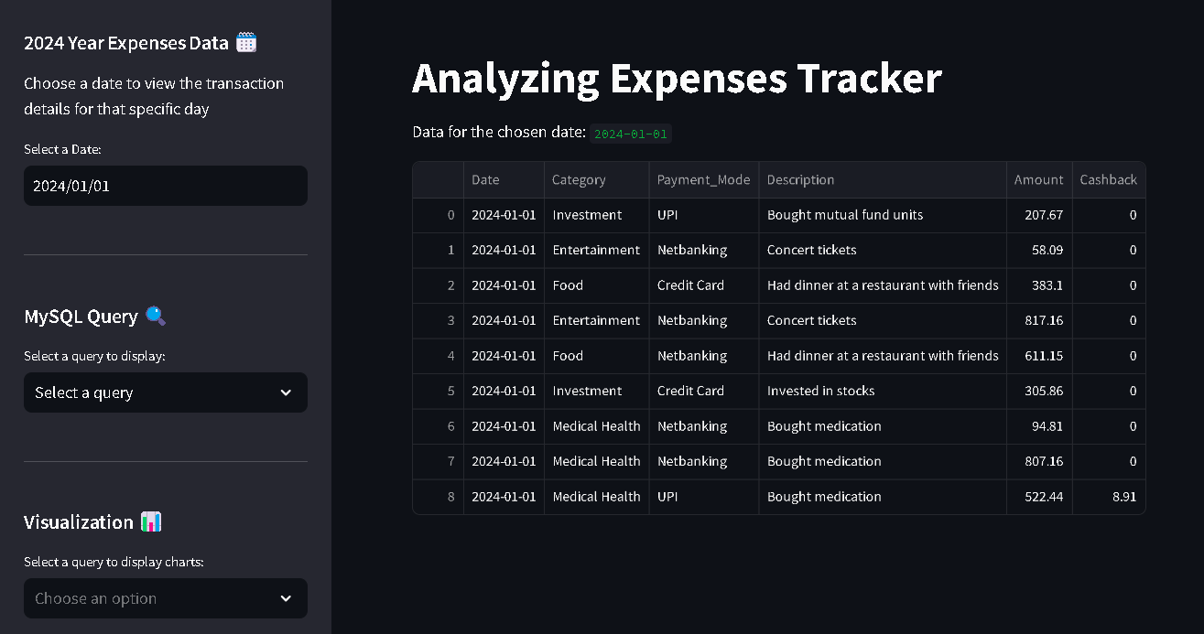
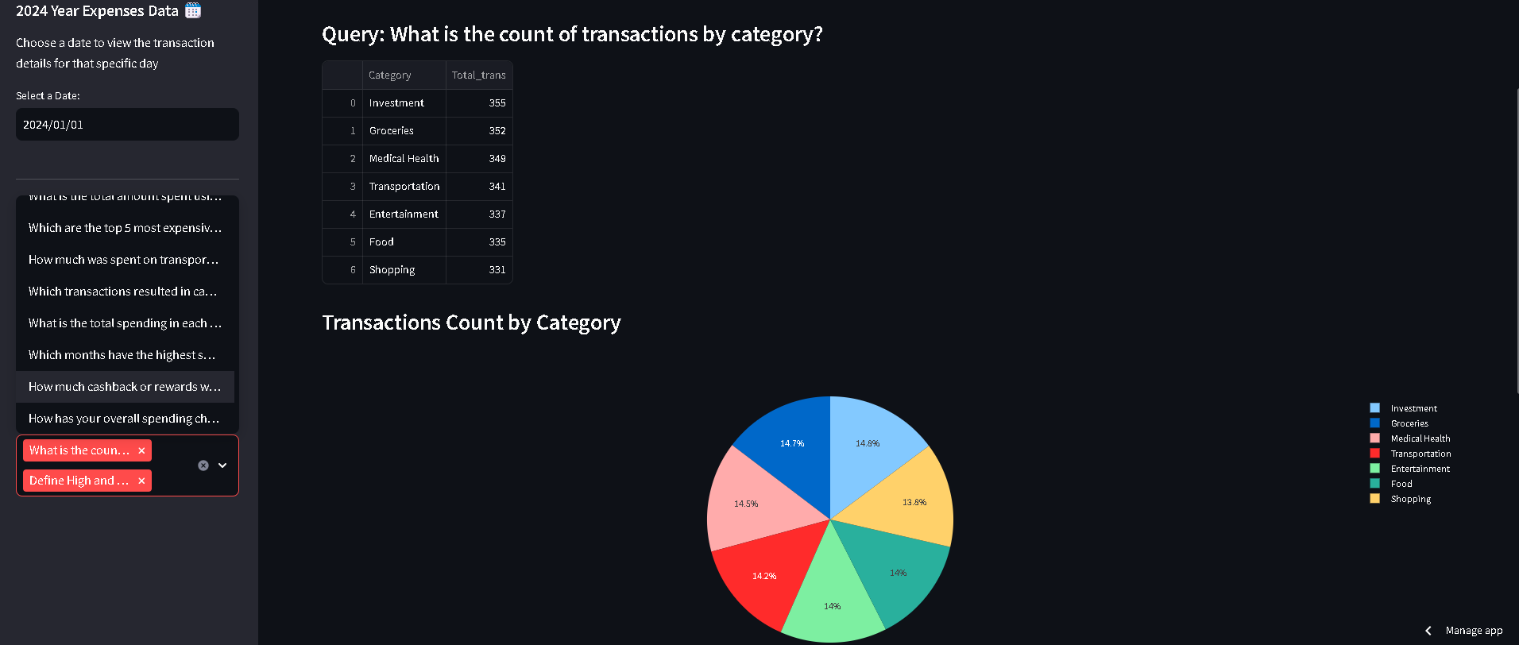

Streamlit App
An interactive web application that transforms personal expense data into actionable financial insights through dynamic, data-driven visualizations.
Provides real-time analytics including category-based expense breakdowns, spending trend analysis, and complex financial information into clear, meaningful metrics.
Dynamically generates visualizations using SQL queries, enabling users to instantly understand total expenses, spending patterns, and transaction frequencies.
App Link:

Slide 18

Key Learnings
Throughout this project, I gained comprehensive skills in dataset generation using the Faker library, including creating multiple CSV files and consolidating them into a single, unified dataset.
I learned advanced Exploratory Data Analysis (EDA) techniques for examining data from multiple perspectives, including robust methods for identifying duplicates, null values, and missing data, and strategies for dataset modification and cleaning.
The project demonstrated proficiency in database connectivity using Python, specifically connecting to MySQL and SQLite3 databases. I developed skills in crafting complex SQL queries to analyze expense data, including breakdown analysis, identifying highest and lowest expense categories, and generating insights for potential financial optimization.
Finally, I leveraged Streamlit to create an interactive, user-friendly application that connects databases, executes SQL queries, and visualizes complex financial data in an accessible, engaging format.

Slide 19
Project Insights and Recommendation
Identifies top spending categories (e.g., Foods, Groceries, etc.).
Tracks monthly expenditure trends, highlighting peak spending months.
Determines which payment mode is used most frequently (Cash vs. Online).
Analyzes how different payment methods impact cashback earnings.
Identifies transactions that resulted in cashback and the total cashback received.
Analyzes how cashback trends change over different months.
Provides recommendations on where to cut costs and save more.
Tracks monthly expenses over the year and highlights patterns of increasing or decreasing spending.
Provides a yearly summary of financial habits, helping users set budgeting goals.
Suggests personalized savings strategies based on spending behavior.
Offers insights into reducing high-cost expenses while maintaining financial stability.
Helps users gain control over their finances by tracking and visualizing expenses.
Provides clear and actionable insights to optimize spending habits.
Encourages financial discipline by identifying unnecessary expenses.
Can be extended to business expense tracking for procurement and budgeting improvements.

Slide 20

Thank you for this opportunity. This project has been an invaluable learning experience that has significantly expanded my skills and knowledge in data analysis, programming, and financial insights.

